Slide 1
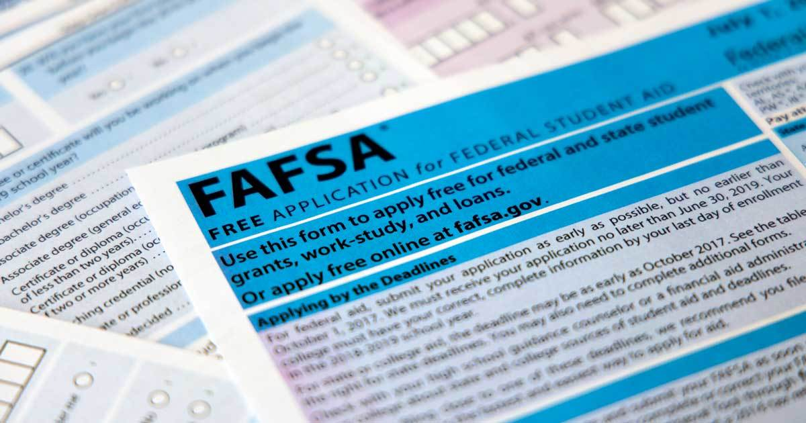
FAFSA FORM & FORMULA CHANGES
This Photo by Unknown Author is licensed under CC BY-NC-ND

Slide 2

CHANGES ARE COMING! ARE YOU READY?
Two pieces of federal legislation were passed that enabled the coming changes
Future Act: Expands access to federal student aid, and mandates Federal Student Aid to use data directly from the IRS-Passed December 2019
FAFSA Simplification Act included with the Consolidated Appropriations Act –Passed December 2020
Was to have started this year but an amendment moved to next FAFSA cycle

Slide 3
implementation for 2024-2025
Streamline the FAFSA Form
Replacing the Expected Family Contribution(EFC) with the Student Aid Index(SAI)
Expanding access to IRS information for majority of filers
Two ways to determine Pell eligibility- SAI formula or Federal Poverty Tables
Notes:
Major aspects of the law include:
1. Replacing the Expected Family Contribution (EFC) with the Student Aid Index (SAI)
Not only will students and families see a different measure of their ability to pay for college, they will also experience a change in the methodology used to determine aid. The new need analysis formula removes the number of family members in college from the calculation, allows a minimum SAI of -$1,500, and implements separate eligibility determination criteria for Federal Pell Grants.
2. Expanding Access to Federal Aid
Federal Pell Grants
The FAFSA Simplification Act will expand the Federal Pell Grant to more students and link eligibility to family size and the federal poverty level.
Incarcerated students will regain the ability to receive a Federal Pell Grant.
Federal Pell Grant lifetime eligibility will be restored to students whose school closed while they were enrolled or if the school is found to have misled the student.
Federal Direct Loans
Repeals the lifetime limit on the period for which a borrower can receive subsidized loans of up to 150% of program length (often referred to as Subsidized Usage Limit Applies, or SULA).
3. Streamlining the FAFSA Form
Reduces number of questions from 108 to 36
Where possible, the law mandates that FSA use data received directly from the Internal Revenue Service (IRS) to calculate Federal Pell Grant eligibility and the SAI. This data exchange has been made possible by the Fostering Undergraduate Talent by Unlocking Resources for Education Act (FUTURE Act), which FSA will implement alongside FAFSA simplification.
The FAFSA Simplification Act also removes questions about Selective Service registration and drug convictions and adds questions about applicants’ sex and race/ethnicity.

Slide 4

STREAMLINING THE FORM
EVERYONE will be required to click a permission box at the beginning of the form to allow their financial information to be transferred into the FAFSA form-including non-tax filers
Process REQUIRES transferring of data from IRS whenever possible
Very limited paths for people to manually enter their financial data-separated couples, non-US tax filers, undocumented parents
Number of questions has been reduced
This Photo by Unknown Author is licensed under CC BY-ND

Slide 5
Streamlining the form
Will confirm non-filers and hopefully eliminate Non-filer letters required for the verification process
Everyone with a separate tax form will have to log-in and grant permission-married filing separately for example
At no time during completing the form, on the FAFSA summary or on the Student Aid Report will you see any of the numbers transferred-”Transferred from the IRS”
Will not have any opportunity to make corrections to these numbers

Slide 6
The Student aid index (SAI)
New name for the EFC
  Better reflects the output from the FAFSA as an index, not as a reflection of what a family can or will pay
SAI could be as low as -$1500, allowing neediest students to receive aid in excess of the Cost of Attendance
  Non-tax filing families will receive automatic -$1500 SAI
SAI determines eligibility for all other types of federal student aid except maximum and minimum Pell awards from the Federal Poverty Tables

Slide 7
Pell grant –determining elibility
Two ways to qualify for a Pell grant
Will use federal Poverty Tables that match the income year to be reported on the FAFSA- next year 2022 income information and 2022 Poverty Table
Pell eligibility determination:
  Is the student eligible for Max Pell per the Poverty Table?
  Is the student eligible for Pell by SAI?
  Is the student eligible by Min Pell per the Poverty Table?
Max/Min Pell is determined by family size, family composition, and AGI
  Family composition- one or two parent household- for dependent students
  Different tables for independent students-married or with dependents
Students will receive the most generous Pell Grant for which they are eligible, either by SAI or the new min/max Pell measures

Slide 8
Sai formula changes
Family size(not household size anymore) will be based on number of people claimed as exemptions on tax forms filed
Will be an option to modify that number if it no longer is an accurate reflection of family size.
Parent info to be provided on the FAFSA will no longer be defined as primary custodial parent. New definition is “parent which provided the greater portion of the student’s financial support”.
SAI will no longer be divided by number in college
If required to report assets, the family would have to report the net value of any business or family farm –no more exemptions for number of business employees or farms on which the family residence is located

Slide 9
FORMULA CHANGE IMPLICATIONS
May require high percentage of families to utilize the question that allows you to change family size-births, deaths, college graduates, criteria in divorce decrees, tax filing choices
With new definition of which parent(s) information belongs on the form-may or may not be the custodial parent, may cause tense situations between student and parent, may modify eligibility for student
How will non-custodial parents feel about having to complete the FAFSA?
Current college students may need to change which parent to report
Loss of eligibility for federal, state and institutional grants

Slide 10
Formula change implications
With number in college removed from the formula-many students may have SAI double or triple with no change in family income
Student may see reduction or loss of Pell Grant or state need-based grant
Will Ohio make any adjustments? To be seen.
Will colleges make any adjustments for current students so to not lose enrollments?
How do you explain changes in financial need when the family income did not change?

Slide 11
Formula change implications
Families with AGI >$60,000 will be required to report assets($50K now)
What effect will it have on SAI when reporting all business net worth and family farm values? Most likely higher SAI with no income change.
How will we guide families to estimate business/farm net worth value?
Can or will colleges consider this as a special circumstance?

Slide 12
New option for students
Creates a “provisional” independent student if they believe they should be due to unusual circumstances and do not/cannot report parent financial information
Student will receive estimated SAI and Pell Grant eligibility notice
Financial aid office will be required to notify students of process and timeline for the dependency appeal process
If appeal is not granted-student will have to provide parent information to be eligible for aid other than an unsubsidized student loan

Slide 13
ItEMS NO LONGER REQUIRED
Cash support and other money paid on behalf of the student(529s in other people’s names)
Veteran’s education benefits
Workman’s compensation
Selective Service question
Drug Conviction question
NOTE: Child support received will be moved to asset section of the form-families that do not need to report assets means this won’t be reported

Slide 14
COUNSELOR CONSIDERATIONS
May wish to update right now any resources, presentations or college information for your current juniors
May wish to consider holding a financial aid information night this spring AND next fall
Encourage households with two parents to each get an FSA ID so either/both can complete the FAFSA
Develop messaging to parents with older college students that things are changing and warn the parents of your current seniors that what happens this year will be different next year
Throw out all old materials for the Class of 2023 when right after graduation
Sign up for every training or webinar offered next year when much more information will be available
Warn you principal/supervisor now that you will need professional development time next year

Slide 15



Formula for FAFSA: LOUISIANA’s Recipe
Tireka Cobb, Ph.D.
Director, Field Outreach Services
Louisiana Office of Student Financial Assistance
A Program of the Board of Regents
October 27, 2022

Slide 16

AGENDA FOR
TODAY’S PRESENTATION
01 Discuss an Overview of the FAFSA Policy
02 Discuss How to Support Counselors & Families
03 Discuss Promising FAFSA Completion Practice
04 Discuss the Importance of Data Integration

Slide 17


ABOUT LOSFA
The Louisiana Office of Student Financial Assistance (LOSFA) is a Program of the Louisiana Board of Regents, that strives to be Louisiana’s first choice for college access by promoting, preparing for and providing equity of college access. LOSFA administers the state’s scholarship and grant programs and the state’s Internal Revenue Code Section 529 college savings program.

Slide 18


ABOUT THE BOARD OF REGENTS
The Board of Regents is a state agency created by the 1974 Louisiana Constitution and coordinates all public higher education in Louisiana. The 15 volunteer members of the Board of Regents are appointed by the Governor to six-year, overlapping terms, with at least one (but not more than two) Regents drawn from each of Louisiana’s seven Congressional districts.
In addition, the Louisiana Council of Student Body Presidents appoints one student member as its representative on the board.

Slide 19

Financial Aid Policy
Facilitate Major Stakeholders
Determine Barriers & Supports
Obtain Necessary Approval
Implement with Opt-out Options

Slide 20

Supporting Professional School Counselors
Involve in Planning
Connect with Professional Development Opportunities (Continuing Education Units CEUs)
Provide Additional Financial Aid Supports
Celebrate Successes
This Photo by Unknown Author is licensed under CC BY-ND

Slide 21

Supporting Professional School Counselors

Slide 22
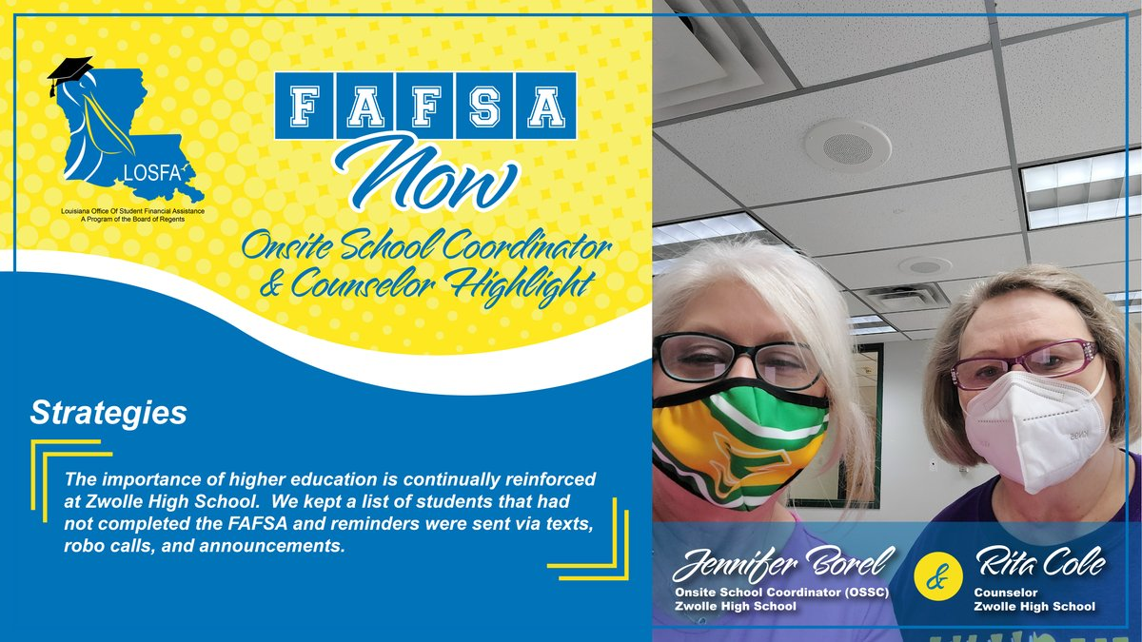
Supporting Professional School Counselors

Slide 23

Supporting Professional School Counselors

Slide 24
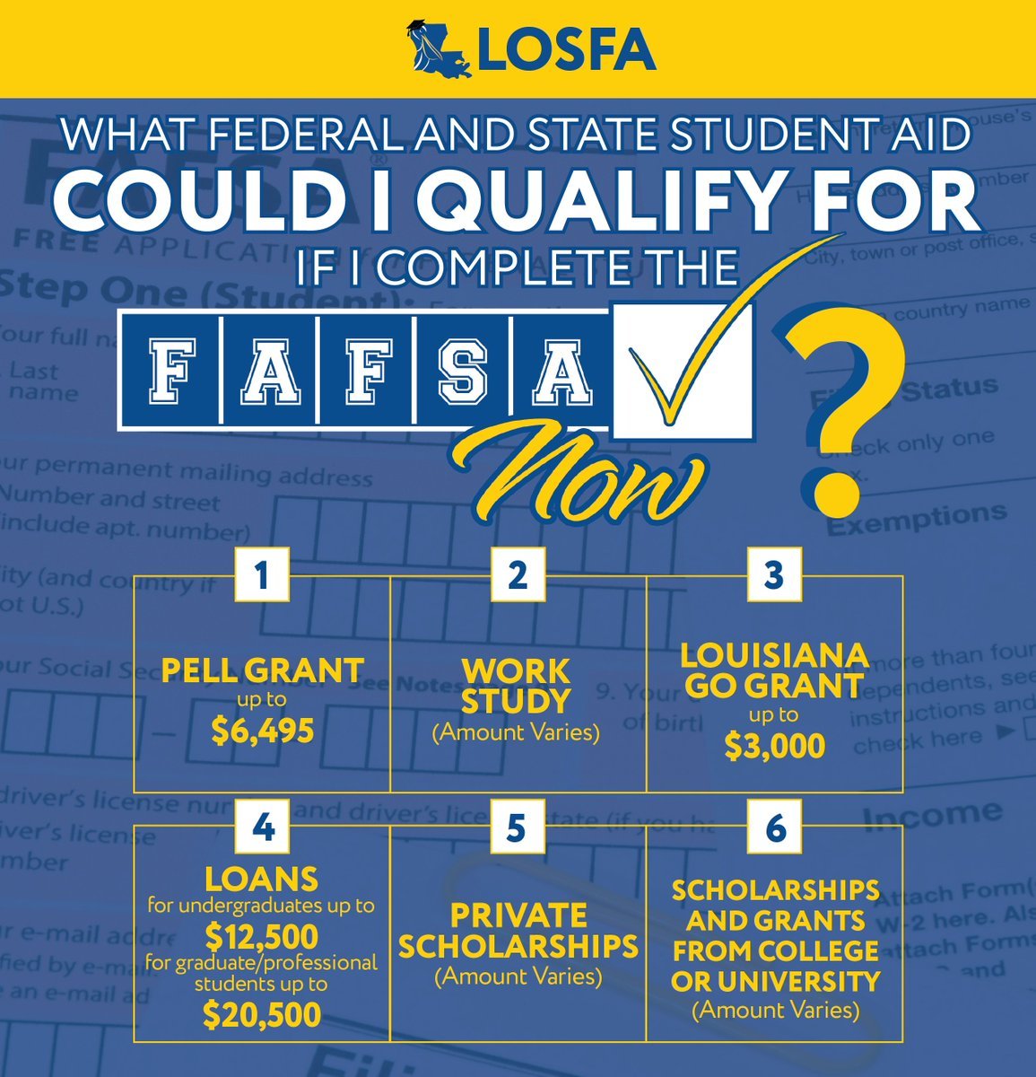
Supporting Professional School Counselors

Slide 25

Supporting Students & Families
Public Service Announcement (PSA)
Connect with the Community
Match & Fit (Connection to Purpose)
In-person and Virtual Options
Telephone Support
Provide Incentives

Slide 26

Supporting Students & Families
Aptitude Match -What are you good at doing?
Academic Match -Who has your major? Where can you get in today?
Cost of Choice Match -Where can you complete with the least amount of loan debt or no loan debt?
Social and Emotional Match -What are your obligations?
Retention Match -Where are students finishing?

Slide 27

Promising Practice
FAFSA Ambassadors
District-wide FAFSA Completion
Partner Involvement
Social Media
Event Coupling
Incentives

Slide 28
Promising Practice: Event Coupling & Incentives
Event Coupling
College Application Events
Senior Pictures
Ring Ceremony
Sporting Events
Report Card/Other Meetings
Incentives
T-shirts
Grad Supply Vouchers
Grad Fee Reduction
Grad/Prom Tickets
Donated Gift Cards

Slide 29



Promising Practice: Events

Slide 30

Integrating Data
FAFSA Completion Project
Compete to Complete
Student Transcript System

Slide 31

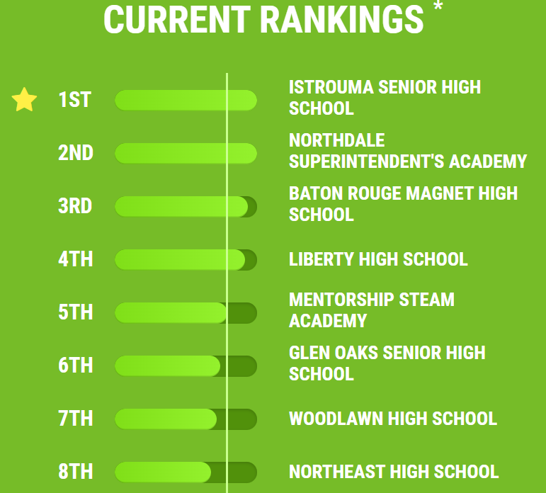

Compete to Complete

Slide 32





CONNECT WITH LOSFA
Facebook
@losfa
Twitter
@losfa
YouTube
@losfa1000
Instagram
@losfa001
LOSFA also uses Signal Vine Text Messaging to connect with students and families. To receive important information and updates from LOSFA, sign up for Signal Vine by texting “LOSFA” to 50065.

Slide 33


CONTACT LOSFA
ON THE WEB
ASK
LEX
www.mylosfa.la.gov
custserv@la.gov
GeauxFAFSA@la.gov
VIRTUAL OFFICE HOURS
LEX is LOSFA’s virtual response assistant
LEX is available on LOSFA’s Website at www.mylosfa.la.gov
Available 24/7 to answer questions about TOPS
9:00 a.m. – 3:00 p.m.
Monday – Friday

Slide 34

I Know I Can
FAFSA COMPLETION
Katina Fullen
kfullen@iknowican.org
www.iknowican.org

Slide 35


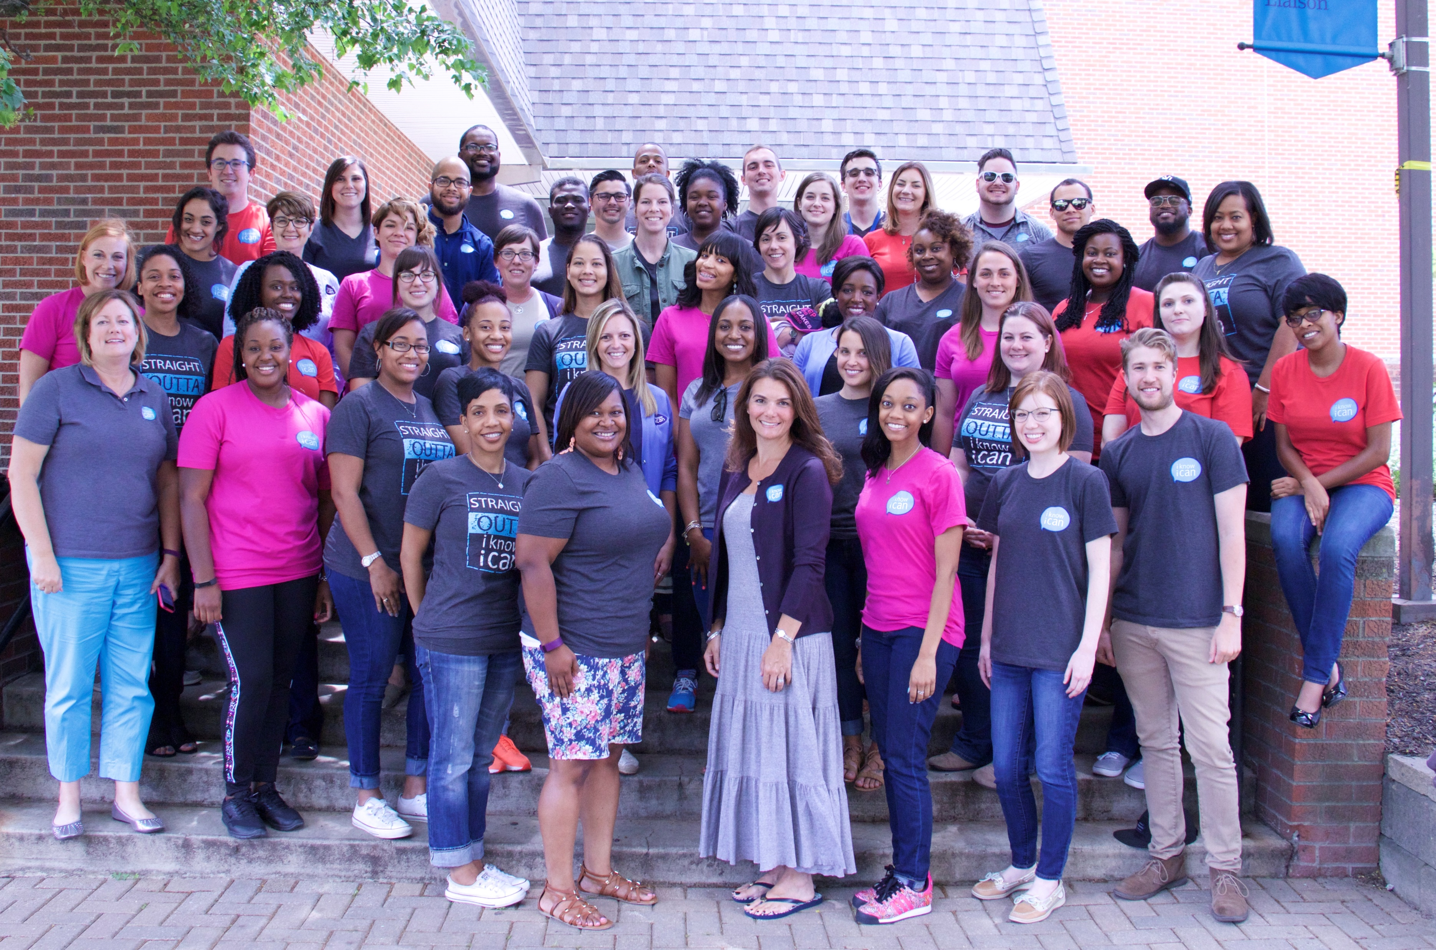

Our Mission
To inspire, enable, and support central Ohio students in pursuing and completing a college education.
    Founded in 1988 in Columbus, OH
    Partners with five central Ohio school districts including:Columbus City Schools, Groveport Madison Schools, Reynoldsburg City Schools, South-Western City Schools, and Whitehall City Schools
    Recipient of ODHE’s FAFSA ‘22 Grant

Slide 36



FAFSA Is Everyone’s Business!
Milestone Completion Data
Awareness & Outreach
Professional Development & Partnerships
Notes:
Milestone Completion – using student level FAFSA data is a gamechanger. Having access to real-time FAFSA data, a system to track college application submission by student allows us to compare FAFSA completion and college application completion (analyzing college app no FAFSA & FAFSA no college app)
Awareness & Outreach – Awareness campaign (radio and commuter ads), translated materials, taking Mobile unit into communities where FAFSA completion rates are low and attending sporting events, setting up graduation tables during actual graduation to inform students and families that it is not too late to apply to college/complete FAFSA
Professional Development & Partnerships – building-level lunch & learns, presentations provided for Admins, Counselors, Family Ambassadors, Athletic Directors, coaches/working together with community partners who serve same students – sharing important dates/talking points to ensure all caring adults are sharing same message.

Slide 37
How Do We Continue To Increase FAFSA Completion
Access to Funding and Resources
Professional Development Beyond The Usual
Simple, Consistent Messaging
Notes:
Expanded /continued Funding – ODHE funding was critical to our success – access to funding and resources for all districts across the state
Widespread Messaging – simple and consistent messages, in multiple languages – can we create consistent yet customizable messaging including statewide media buys?
Expand professional development, not just counselors and principals - every adult who has relationships with students should understand the importance of FAFSA completion. Not asking all adults to be the FAFSA experts, but to understand the why, when, and how

